Slide 1
Lecture 1 – Grab Bag
Paula Hannan
hannanp@oit.edu
Last Changed: 08/11/26 03:59:47 AM

Slide 2
CST126 – C++ Programming II
Today's Drill
  Welcome and Orientation
  Review 116 for transfer students
  Miscellaneous C++ Topics
  Sections 8.2 and 8.3
  Review

Slide 3
Review 116 For Transfer Students
Can you write code that uses the following in C++?
Loops and control structures
Functions, both call by value and call by reference
Structures
Basic classes with constructors
One-Dimension Arrays
Simple Stream processing?
If Yes, you are in the right class.

Slide 4
Review 116 For Transfer Students
If you have a single area of weakness, come talk to me about how to review.
If this is too much come talk to me about CST116 on Thursday Nights.

Slide 5
Our Objectives This Term:
Students should be able to:
  1. Understand string storage and manipulation
  2. Manipulate multi-dimensional arrays.
  3. Allocate and manage dynamic memory.
  4. Perform simple linked list operations.
  5. Understand friend functions.
  6. Understand operator overloading.
  7. Perform binary file I/O.
  8. Use and Create Recursive Programs
  9. Understand inheritance basics.

Slide 6
Today's Learning Objectives
Be able to:
Use Enum's
Use Bitwise Operators
Describe when Bitwise Operators and when not to.
Be able to use and know when to use separate .h and .cpp files.
Be able to use compiler directives such as #ifndef
And finally be able to use namespaces.

Slide 7
Using Enum's
Enums are a way to group constants. Remember when we had:
enum Suits {Heart, Spade, Diamond, Club};
Then if you said
  cout << Spade;
You would get a 1.

Slide 8
Enums
enum Suits {Heart, Spade,Diamond, Club};
You could also say;
  Suits cardSuit;
  cardSuit = Club;

Slide 9
Enums
You can also override the automatic numbering.
enum Suits {Heart, Spade=3,
Diamond, Club};
Can you think of an example why you would want to override the automatic numbering?

Slide 10
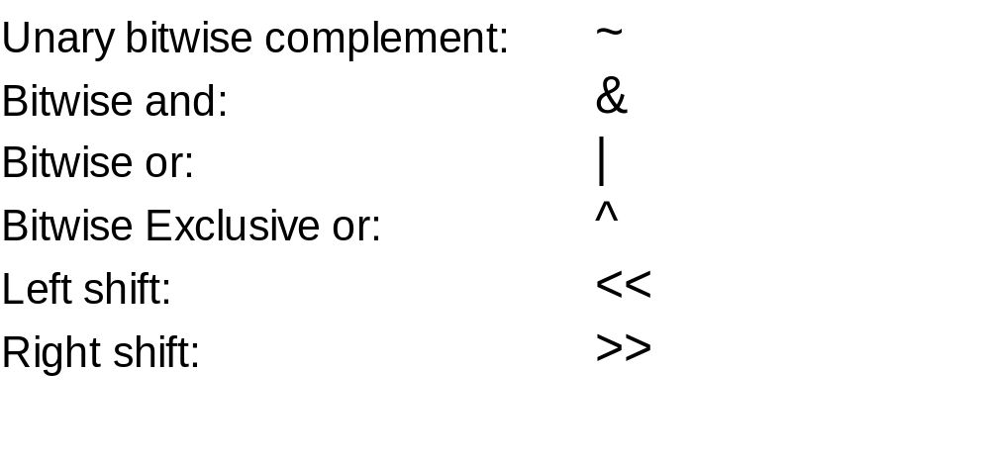
Bitwise Operators
There are a group of operators that work on variables at a bit level. They are:

Slide 11
Bitwise Operators
Each bit has a 1 or 0
Variables using bitwise operators should be declared as int or char (perferably unsigned) Ie
    unsigned int x;
Many compilers limit number of bits.
Be careful, Bit operators can lack portability.

Slide 12
Unary bitwise complement: ~
Flips the bits all 1's become 0's and all 0's become 1's.
Also called the "ones complement operator."
For example if x = 100000001 then
~x = 011111110

Slide 13
Bitwise and: & -- Bitwise or: |
For both, the two arguments are operated on bit by bit.
  For & if both bits are 1 the result is 1. If either bit is 0 the result is 0.
  For | if one or both bits are 1 the result is one. If both are 0 the result is zero.
  4 | 8 => 0100 | 1000 => 1100
  4 & 8 => 0100 & 1000 => 0000
  6 | 2 => 110 | 010 => ?
  6 & 2 => 110 & 010 => ?

Slide 14
Bitwise Exclusive or: ^
Like & and | the two arguments are operated on bit by bit.
If one or the other but not both is 1 then the or is 1.
  An exclusive or is a Mom's or... you can have cake or cookies but not both.
  4 ^ 8 => 0100 | 1000 => 1100
  6 ^ 2 => 110 | 010 => ?

Slide 15
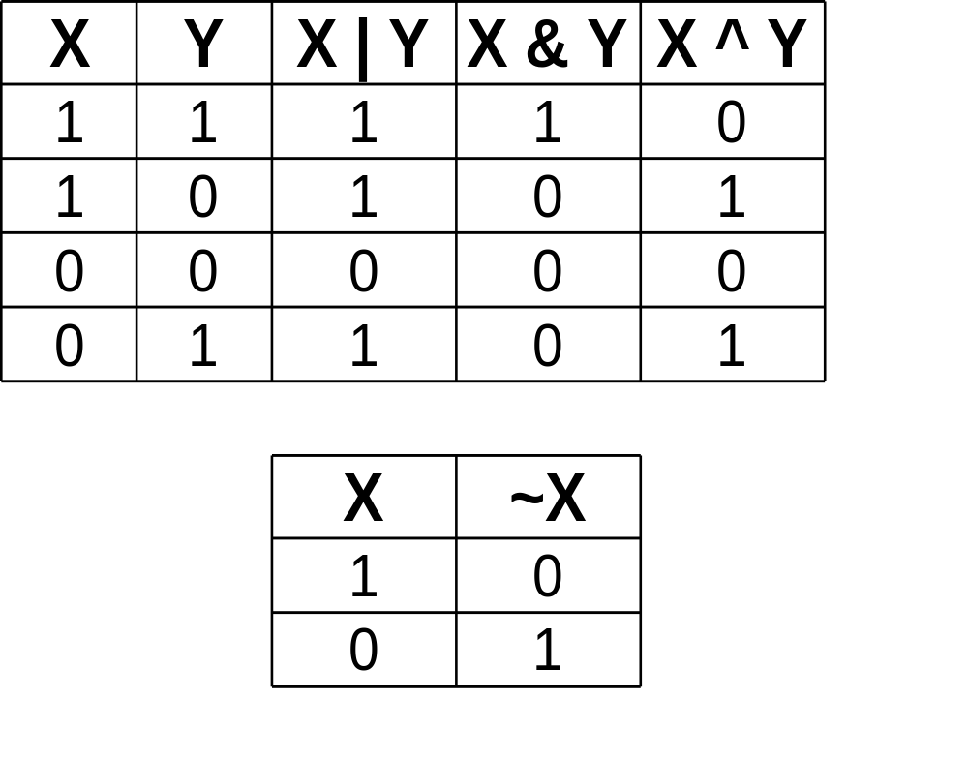
Bitwise Truth Table

Slide 16
Left Shift and Right Shift
To use the shift operator the operands must be integers. The form is:
  y = x << #bits to shift left
  y = x >> #bits to shift right.
With unsigned operands, the low order bits are replaced by 0.
With signed operands its compiler dependent. It could be 0 or the sign.

Slide 17
Shifts:
For example to get 8 (1000) I could:
  4 << 1; // 4 is 100 in binary
  16 >> 1; // 16 is 10000
Say for example on a web page you stored a color as rrrrbbbbgggg
  You could peel off the red, blue and green element with a shift.

Slide 18
Bitwise Play
What is:
  1 & 4 ?
  3 & 1 ?
  1 ^ 4 ?
  1 << 2 ?

Slide 19
When to use Bitwise Operators
Bitwise operators are used in low level programing.
  For example device device drives
  Network programming
  Checksums
  OS programming
You use bitwise programming when the efficiency is more important than readability.
  Some web scripting situation may meet this criteria.

Slide 20
The Bitwise Soapbox
Bitwise operators are NOT appropriate for most business scenarios.
  Breaks design goal that each variable only serve one purpose.
  Optimize your database access for the most performance improvement.
Be careful using bitwise operators in a shop that doesn't have experience with them.
  At the very least document.

Slide 21
Separate compilation
Most applications are build from several files.
What advantages do you see for separate files?

Slide 22
Separate compilation
Most applications are build from several files.
What advantages do you see for separate files?
  Easier to distribute among many programmers.
  Can separate implementation and interface.
  Can reuse components.
  Improves readability by grouping like function.

Slide 23
Include files
When we use library include files we say
  #include <blah.h>
When we create our own include files we say
  #include "zippy.h"
With Visual C++
  Put the .h file in your project.
  Tell the compiler NOT to include the .h in the compile.
    The #include statement does this for you.

Slide 24
Separate .cpp files
With Visual C++ include the .cpp file in your project.
With other compilers you may need to say (generally at the end of the cpp file.)
#include "zippy.cpp"
Still other linkers may use a make file, a file that tells the linker what objects are needed.

Slide 25
When do you Use Includes?
Ask yourself the following questions:
  Am I going to reuse this file in another situation?
  Are all the functions / data in my current item related to a specific theme or topic?
    Most code I've seen has a separate .h and .cpp file for each object.
  Would it help me keep things straight if I reorganized into separate files?

Slide 26
Using #ifndef
Open up the string.h file. (Use the NT find function)
Notice the #ifndef, the #endif and the #define.
ifndef stands for IF Not DEFined.
Everything between the #ifndef and #endif is only executed one time
This allows you to include string.h in every component .h or .cpp file without getting redefinition errors.

Slide 27
Preprocessor directives
#include, #ifndef ect are preprocessor directives
The preprocessor manipulates the C++ file before the compiler gets to it.
SO, if you use #ifndef, the #endif and #define the pre-processor will take out multiple occurrences of a .h file before the compiler sees it.

Slide 28
Hands-On
Pair Up – One student who took CST116 with me and one Student who didn't.
Look at and explain to each other the bj_card.cpp example program from last term.
    ...../~hannanp/fall

Slide 29
Namespaces Review
Purpose:
  Create a separate group of names so that the same name can be used both inside and outside the namespace without conflict.
  To drive your instructor Crazy.
    My compiler handles <iostream> differently then visual c++. namespace std requires <iostream>, so you may have to convert my code.
    Some day I may find a way that Microsoft and Borland will play nice together, until then...
    Welcome to the wonderful world of porting, a common real world task.

Slide 30
Namespace Syntax
Syntax – Setting up a namespace
        namespace name {
        declarations
        }
For example:
  namespace highway {
    int shoulder;
  }
  namespace massage {
    double shoulder;
  }

Slide 31
Syntax – Using the namespace in your program
Alerting the program that you will always use a particular namespace
  using namespace namespace_name
    ie: using namespace std
If you use this at the top of your program, you are changing the "global namespace".
Preferred is to include the using statement in any function that needs it instead of globally.

Slide 32
Using namespaces in your program
Alerting a program that all future uses of fieldname x will come from namespace y.
  using namespace::symbol
    ie
    using massage::shoulder;
    shoulder = 6;

Slide 33
Syntax – Using the namespace in your program
And finally, using a field within the new namespace
  namespace:: symbol
  ie
    highway::shoulder = 5;

Slide 34
Hands-On
Now that you understand / remember the old version look at the new version.
  Notice the new card.h and card.cpp
  Notice that I made the member variables private and made access / update functions
  Notice the use of the namespace std

Slide 35
Have we met the objectives?
Can You?
  Use Enum's?
  Use Bitwise Operators?
  Describe when Bitwise Operators and when not to?
  Use separate .h and .cpp files?
    Do you know when to use separate .h and .cpp files?
  Use compiler directives such as #ifndef?
  Use namespaces?

Slide 36
Today's Index card
For 5 points:
  Front => Three important points
  Back =>
    One thing you think I should review.
    What good thing will you get from taking this class?
Note: What you think I should review is not necessarily about you. It could be:
  The most difficult topic. (Even if you got it.)
  Something where the slide was unclear.

Slide 37
After Class Review – Namespaces
The namespace std was added as part of the C++ standardization process – In other words its new.
When they added namespace std they decided to standardize header file extensions and made the new header files. (ie <iostream> Vs <iostream.h>)
Once you start to use namespace std its better not to mix and match old style files and new style files.
This slide and the next was aided by The C++ Standard Library, Nicholi Josuttis

Slide 38
After Class Review - Namespaces
Namespaces are extendable; I can have a piece of my namespace in many include files. IE in bridge.h I have:
        namespace highway {
        int bridge_type;
        };
And in road.h
        namespace highway {
        int shoulder
        };
Then when I include bridge.h and road.h I have both highway::bridge_type and highway::shoulder.

Slide 39
After Class Review – Namespaces
SO....
Namespace std is defined in many include files.
Another reason not to mix old and new styles is that there are are some interdependencies between include files.
  For example iomanip includes iostream . If you have:
    #include <iostream.h>
    #include <iomanip>
  You now have both iostream and iostream.h in your program.

Slide 40
After Class Review - #define
The syntax for making constants with the #define preprocessor directive is:
#define constant replacement
or
#define constant
ie
#define PI 3.14159
#define SKIP_ME

Slide 41
After Class Review - #ifndef
The syntax for #ifndef is:
  #ifndef symbol
  .........
  #endif
IE
  #ifndef SKIP_ME
  #endif /*SKIP_ME*/
There also is:
  #ifdef symbol
  #endif

Slide 42
After Class Review – Other preprocesor if's
Just FYI, there is also a standard preprocessor if statement.
#if expression
......
#elif expression //#elif is optional
.......
#else // #else is optional
.......
#endif

